Slide 1
Shapes
Presenter Name

Slide 2
Agenda
Topic one
Topic two
Topic three
Topic four

Slide 3


Introduction
With PowerPoint, you can create presentations and share your work with others, wherever they are. Type the text you want here to get started. You can also add images, art, and videos on this template. Save to OneDrive and access your presentations from your computer, tablet, or phone.

Slide 4
Topic one
Subtitle

Slide 5
Chart

Slide 6
Table
 | Category 1 | Category 2 | Category 3 | Category 4
Item 1 | 4.5 | 2.3 | 1.7 | 5
Item 2 | 3.2 | 5.1 | 4.4 | 3
Item 3 | 2.1 | 1.7 | 2.5 | 2.8
Item 4 | 4.5 | 2.2 | 1.7 | 7

Slide 7

The way to get started is to quit talking and begin doing.
Walt Disney

Slide 8
Team
Name Title
Name Title
Name Title
Name Title

Slide 9
Timeline
To start a presentation, go to the Slide Show tab, and select From Beginning.
1
To display Presenter view, in Slide Show view, on the control bar at the bottom left select the three dots, and then Show Presenter View.
2
During your presentation, the speaker notes are visible on your monitor, but aren't visible to the audience.
3
The Notes pane is a box that appears below each slide. Tap it to add notes.
4
If you don’t see the Notes pane or it is completely minimized, click Notes on the task bar across the bottom of the PowerPoint window.
5

Slide 10
Content
Subtitle
Subtitle
Add text, images, art, and videos.
Add transitions, animations, and motion.
Save to OneDrive, to get to your presentations from your computer, tablet, or phone.
Open the Design Ideas pane for instant slide makeovers.
When we have design ideas, we’ll show them to you right there.

Slide 11
Content
Subtitle
Subtitle
Subtitle
Add text, images, art, and videos.
Add transitions, animations, and motion.
Save to OneDrive, to get to your presentations from your computer, tablet, or phone.
Open the Design Ideas pane for instant slide makeovers.
When we have design ideas, we’ll show them to you right there.
This PowerPoint theme uses its own unique set of colors, fonts, and effects to create the overall look and feel of these slides.
PowerPoint has tons of themes to give your presentation just the right personality.

Slide 12

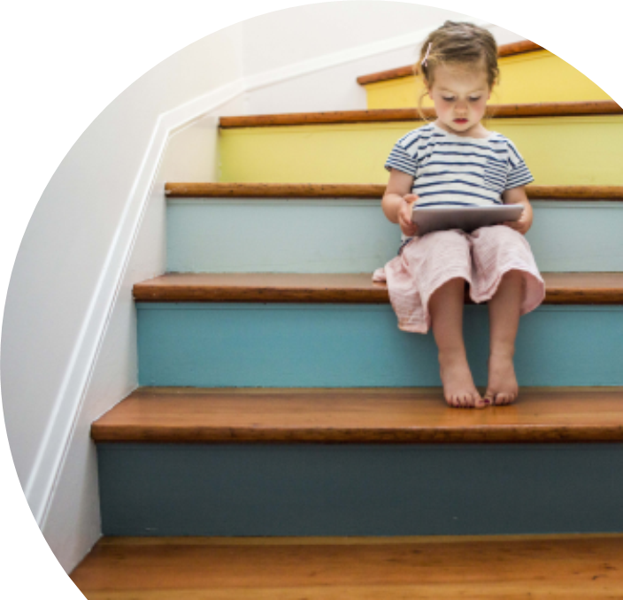
Summary
With PowerPoint, you can create presentations and share your work with others, wherever they are. Type the text you want here to get started. You can also add images, art, and videos on this template. Save to OneDrive and access your presentations from your computer, tablet, or phone.

Slide 13
Thank you
Presenter name
Email address
Website

Slide 14
Secant Method

Slide 15
Secant Method
The secant method is a root-finding numerical algorithm used for approximating the roots of a real-valued function.
It iteratively refines two initial guesses to converge towards a more accurate estimate of the root.
Secant method is similar to the Newton-Raphson method, but does not require calculating derivatives. Instead, it uses a linear approximation based on two previous iterates to estimate the next root.

Slide 16
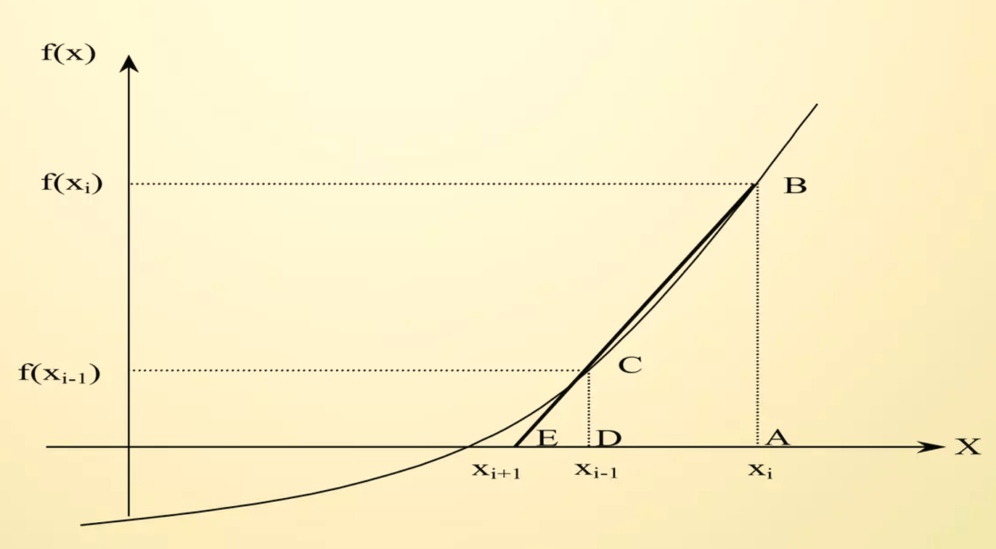
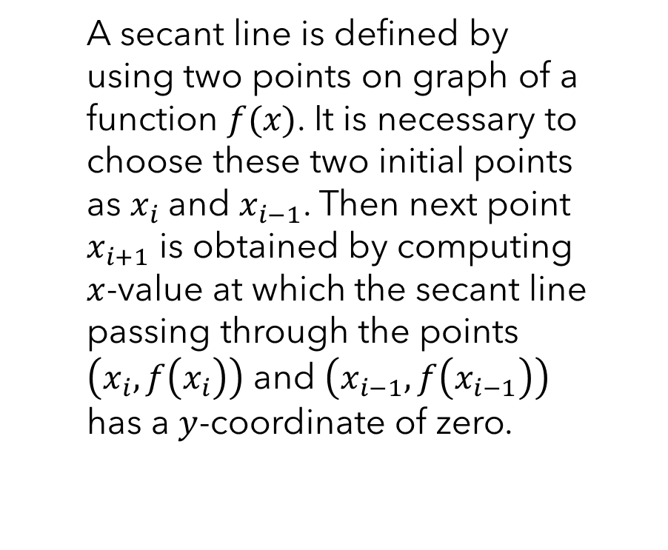
How does it works:
A secant line is defined by using two points on graph of a function $f(x)$. It is necessary to choose these two initial points as $x_{i}$and $x_{i−1}$. Then next point $x_{i+1}$ is obtained by computing $x$-value at which the secant line passing through the points $\left.\left(x_{i}, f\left.\left(x_{i}\right.\right)\right.\right)$ and $\left.\left(x_{i−1}, f\left.\left(x_{i−1}\right.\right)\right.\right)$ has a $y$-coordinate of zero.

Slide 17
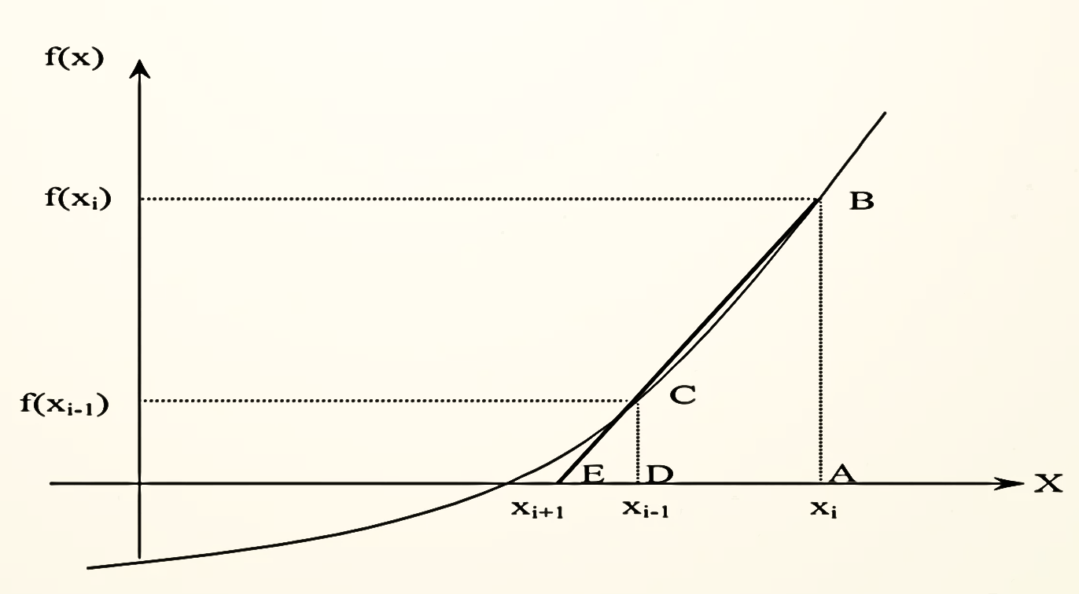
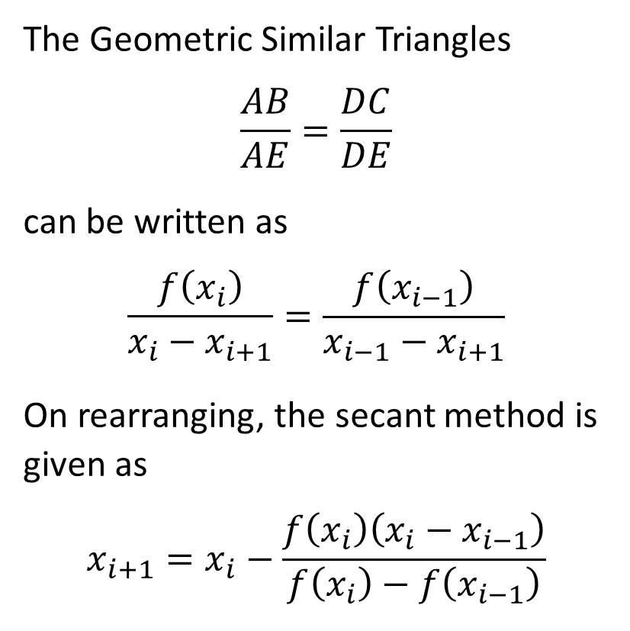
The Geometric Similar Triangles
$$\frac{AB}{AE}=\frac{DC}{DE}$$
can be written as
$$\frac{f\left(x_{i}\right)}{x_{i}−x_{i+1}}=\frac{f\left(x_{i−1}\right)}{x_{i−1}−x_{i+1}}$$
On rearranging, the secant method is given as
$$x_{i+1}=x_{i}−\frac{f\left(x_{i}\right)\left(x_{i}−x_{i−1}\right)}{f\left(x_{i}\right)−f\left(x_{i−1}\right)}$$

Slide 18
Advantages
Versatility: The secant method is versatile and applicable to a wide range of functions.
Generally converges faster than the bisection method
Requires two guesses that don’t need to bracket the root.
No Derivative Required: Unlike some other numerical methods, the secant method does not require the computation of derivatives which makes it better as in some cases derivative become very hard to find.

Slide 19
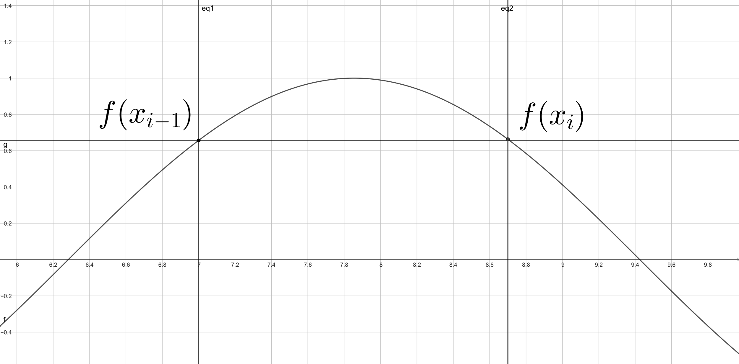
Disadvantages
Convergence: Convergence may not be guaranteed for all functions or initial guesses.
Sensitivity to Initial Guesses: The choice of initial guesses can affect convergence speed and the possibility of convergence.
Division by zero

